Slide 1
Prediction of Sun Flares
T. Anjali Shivani, S.Sahithi, E.V.S.Siva Sankaram
Naxxatra: Science and Collaboration
October 20, 2021

Slide 2
Table of contents
Problem Statement
What is our problem Statement
Introduction Solar activities
Introduction
Sun Flares
Introduction to Sun Flares
Importance of Prediction
Why one have predict the sun flares
Project Background
Technical terminologies
Data base
How these satellites take data
Training Data
Data Sets
Flow Chart
Data Sets
Conclusion
Conclusion and Future scope
•
Short title •
•

Slide 3
Problem Statement
Problem Statement
To develop model for forecasting Disturbance Storm-Time Index for predicting sun flares at t , t+1 min.
Under operationally viable constraints, using the real-time solar-wind (RTSW) data feeds from NOAA’s DSCOVR and NASA’s ACE satellites
With reduced errors in model.
•
Short title •
•

Slide 4
Introduction
Introduction Solar activities
Sun vomits plasma and other awful into the solar system
Sun-storms are of many types: Sun-flares, coronal mass ejections.
They race through the solar-system with the speed of light, peeping up protons into the solar winds.
•
Short title •
•

Slide 5
Introduction
Introduction to Sun Flares
Coronal mass ejection will travel at the speed of 9Km/h which doesn’t effect the Earth.
Electrified plasma from CME is deflected by the earth’s magnetic field deviating the energy to the north and south poles which causes the atmosphere to glow beautiful auroras.
•
Short title •
•

Slide 7
Introduction
Why one have predict the sun flares
Thousands years ago, these sun flares might not effect humans. It only shows a beautiful auroras.
But today’s world is fully with electronics making the effect of flares worst. There might be possibility of solar block out.
•
Short title •
•

Slide 8
Project Background
Technical terminologies
The efficient transfer of energy from solar-wind into the Earth’s magnetic field causes geomagnetic storms.
The resulting ground magnetic field variations increase the errors of systems that use Earth’s natural magnetic field as a pointing reference.
The Disturbance-storm-time index is a measure of the severity of the geomagnetic storm.
More specifically, the negative deflection of the Earth’s magnetic field due to the ring current (see the above figure) is measured by the Dst index.
•
Short title •
•

Slide 9
How these satellites take data
Data Base
The observatory-based Dst values are not very useful for the real-time magnetic modeling due to latency, instrument outages and connectivity issues.
models predict the Dst values solely based on solar-wind measurements by satellites such as NOAA’s Deep Space Climate Observatory (DSCOVR) or NASA’s Advanced Composition Explorer (ACE).
Situated approximately 1.6 million kilometers away from Earth along the Sun-Earth line.
Since radio communication is faster than the solar wind, the satellite measurements at L1 provide 15-30 minutes of lead-time before the storm arrives on Earth.
Few from the Kaggle open source data
•
Short title •
•

Slide 10
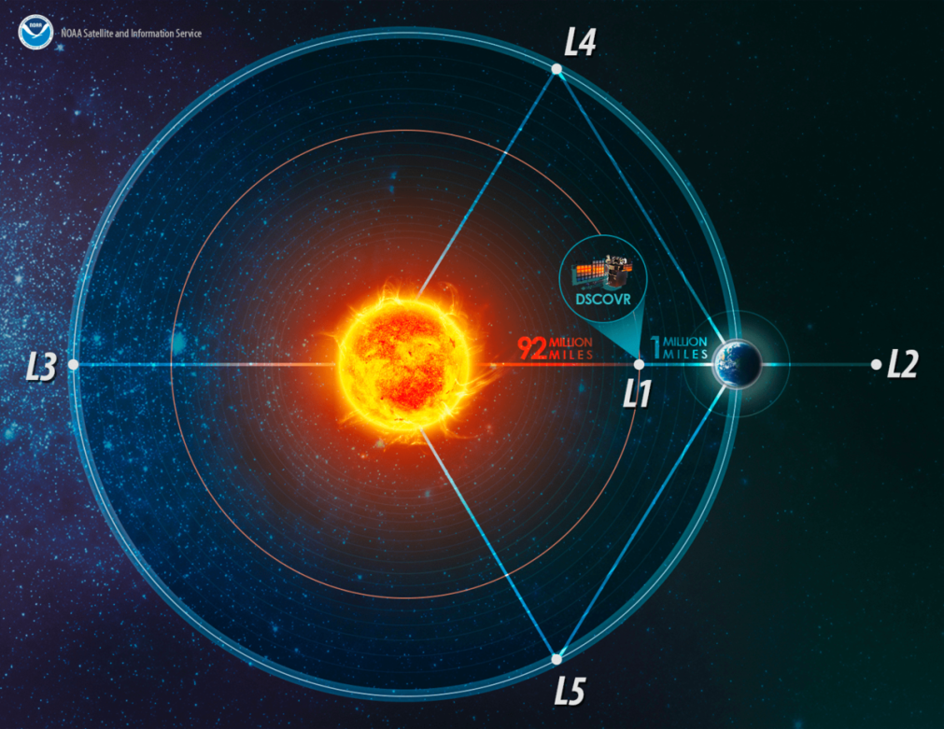

Slide 11
Training Data
Insight of data sets
solar wind: Solar wind data collected from ACE and DSCOVR satellites minutely
Sun spots: Monthly Smoothed sunspot counts
Satellite Positions: Daily Coordinate positions for ACE and DSCOVR
DST : hourly Dst values averaged across the four stations
•
Short title •
•

Slide 12
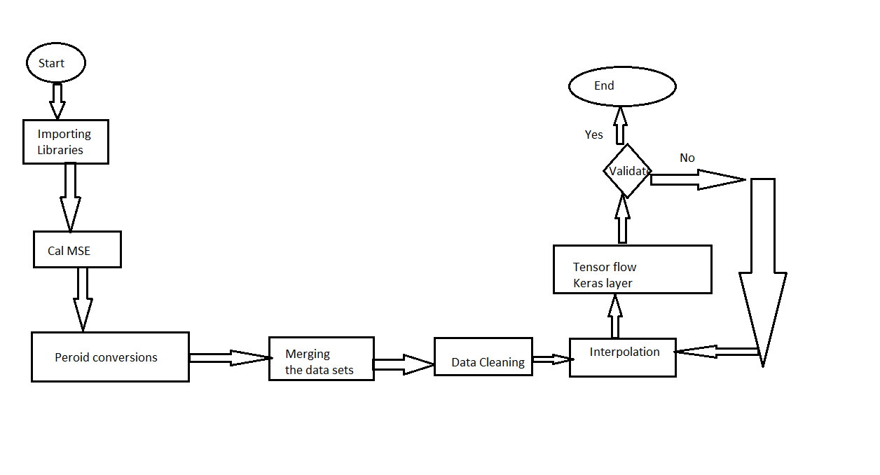
Flow Chart
Flow chart
•
Short title •
•

Slide 13
Conclusion
Conclusion and Future scope
As you can see we are still working on prediction model.
Our previous machine learning model gave us 79 percent of predicted value
We are working implemented the model using the neutral networking.
•
Short title •
•

